Slide 1

Computer Networking: A Top Down Approach
Seventh Edition
Chapter 8
Security in Computer Networks
Copyright © 2017, 2013, 2010 Pearson Education, Inc. All Rights Reserved
Notes:
If this PowerPoint presentation contains mathematical equations, you may need to check that your computer has the following installed:
1) MathType Plugin
2) Math Player (free versions available)
3) NVDA Reader (free versions available)

Slide 2
Network Security
Chapter goals:
understand principles of network security:
cryptography and its many uses beyond “confidentiality”
authentication
message integrity
security in practice:
firewalls and intrusion detection systems
security in application, transport, network, link layers

Slide 3
Learning Objectives (1 of 9)
8.1 What is network security?
8.2 Principles of cryptography
8.3 Message integrity, authentication
8.4 Securing e-mail
8.5 Securing T C P connections: S0S L
8.6 Network layer security: IPsec
8.7 Securing wireless LANs
8.8 Operational security: firewalls and I D S

Slide 4

What is Network Security?
confidentiality: only sender, intended receiver should “understand” message contents
sender encrypts message
receiver decrypts message
authentication: sender, receiver want to confirm identity of each other
message integrity: sender, receiver want to ensure message not altered (in transit, or afterwards) without detection
access and availability: services must be accessible and available to users

Slide 5
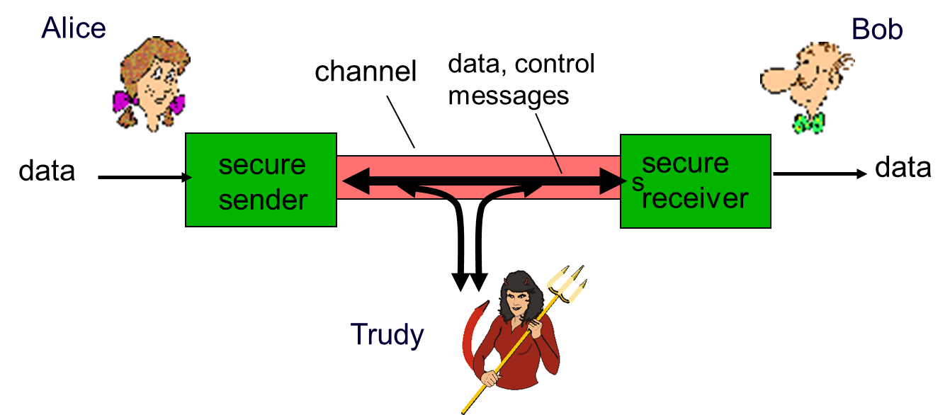
Friends and Enemies: Alice, Bob, Trudy
well-known in network security world
Bob, Alice (lovers!) want to communicate “securely”
Trudy (intruder) may intercept, delete, add messages

Slide 6
Who Might Bob, Alice Be?
… well, real-life Bobs and Alices!
Web browser/server for electronic transactions (e.g., on-line purchases)
on-line banking client/server
D N S servers
routers exchanging routing table updates
other examples?

Slide 7
There are Bad Guys (and Girls) Out There!
Q: What can a “bad guy” do?
A: A lot! See section 1.6
eavesdrop: intercept messages
actively insert messages into connection
impersonation: can fake (spoof) source address in packet (or any field in packet)
hijacking: “take over” ongoing connection by removing sender or receiver, inserting himself in place
denial of service: prevent service from being used by others (e.g., by overloading resources)

Slide 8
Learning Objectives (2 of 9)
8.1 What is network security?
8.2 Principles of cryptography
8.3 Message integrity, authentication
8.4 Securing e-mail
8.5 Securing T C P connections: S S L
8.6 Network layer security: IPsec
8.7 Securing wireless LANs
8.8 Operational security: firewalls and I D S

Slide 9
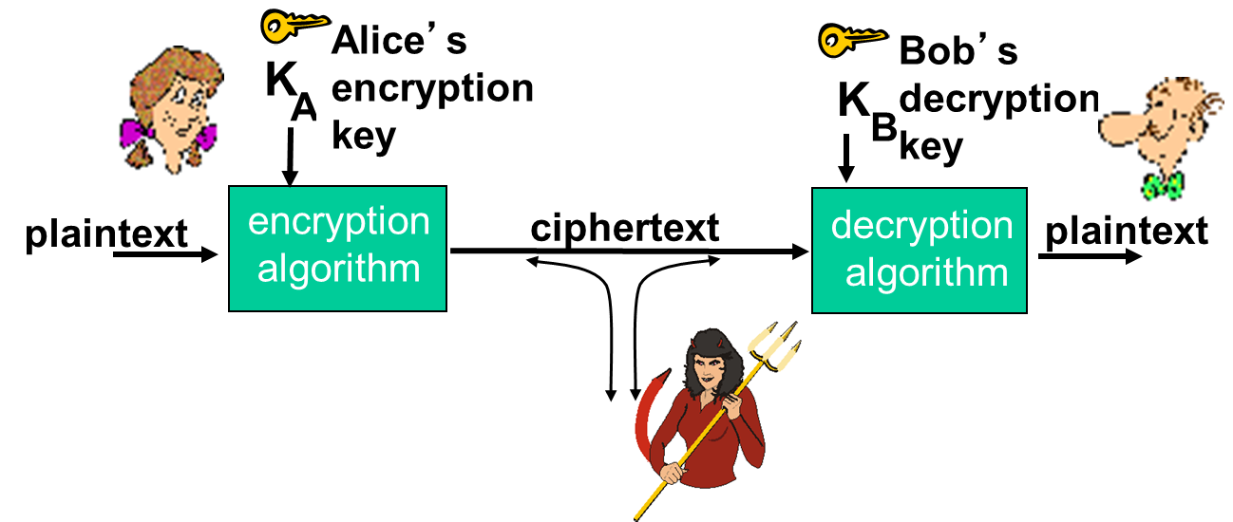
The Language of Cryptography
m plaintext message
ciphertext, encrypted with key

Slide 10
Breaking an Encryption Scheme
cipher-text only attack: Trudy has ciphertext she can analyze
two approaches:
brute force: search through all keys
statistical analysis
known-plaintext attack: Trudy has plaintext corresponding to ciphertext
e.g., in monoalphabetic cipher, Trudy determines pairings for a,l,i,c,e,b,o,
chosen-plaintext attack: Trudy can get ciphertext for chosen plaintext

Slide 11
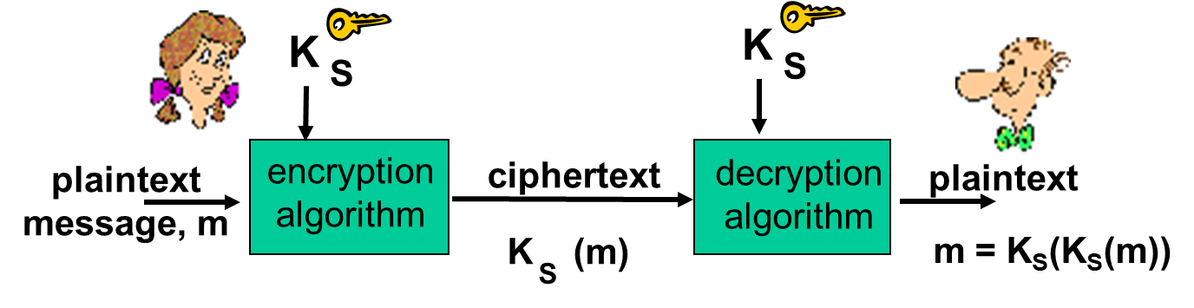
Symmetric Key Cryptography
symmetric key crypto: Bob and Alice share same (symmetric) key: K_{s}
e.g., key is knowing substitution pattern in mono alphabetic substitution cipher
Q: how do Bob and Alice agree on key value?

Slide 12
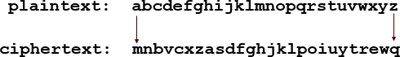
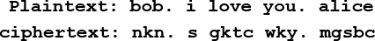
Simple Encryption Scheme
substitution cipher: substituting one thing for another
monoalphabetic cipher: substitute one letter for another
e.g.:
Encryption key: mapping from set of 26 letters to set of 26 letters

Slide 13
A More Sophisticated Encryption Approach
n substitution ciphers, M₁,M₂,…,M_{n}
cycling pattern:
e.g., n=4: M₁,M₃,M₄,M₃,M₂; M₁,M₃,M₄,M₃,M₂; ..
for each new plaintext symbol, use subsequent substitution pattern in cyclic pattern
dog: d from M₁, o from M₃, g from M₄
Encryption key: n substitution ciphers, and cyclic pattern
key need not be just n-bit pattern

Slide 14
Symmetric Key Crypto: D E S (1 of 2)
D E S: Data Encryption Standard
U S encryption standard [N I S T 1993]
56-bit symmetric key, 64-bit plaintext input
block cipher with cipher block chaining
how secure is D E S?
D E S Challenge: 56-bit-key-encrypted phrase decrypted (brute force) in less than a day
no known good analytic attack
making D E S more secure:
3D E S: encrypt 3 times with 3 different keys

Slide 15
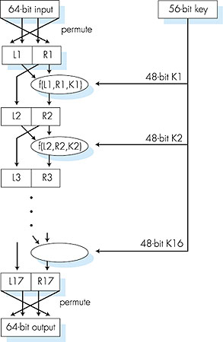
Symmetric Key Crypto: D E S (2 of 2)
D E S operation
initial permutation 16 identical “rounds” of function application, each using different 48 bits of key final permutation

Slide 16
A E S: Advanced Encryption Standard
symmetric-key N I S T standard, replaced D E S (Nov 2001)
processes data in 128 bit blocks
128, 192, or 256 bit keys
brute force decryption (try each key) taking 1 sec on D E S, takes 149 trillion years for A E S

Slide 17
Public Key Cryptography (1 of 2)
symmetric key crypto
requires sender, receiver know shared secret key
Q: how to agree on key in first place (particularly if never “met”)?
public key crypto
radically different approach [Diffie-Hellman76, R S A78]
sender, receiver do not share secret key
public encryption key known to all
private decryption key known only to receiver

Slide 18
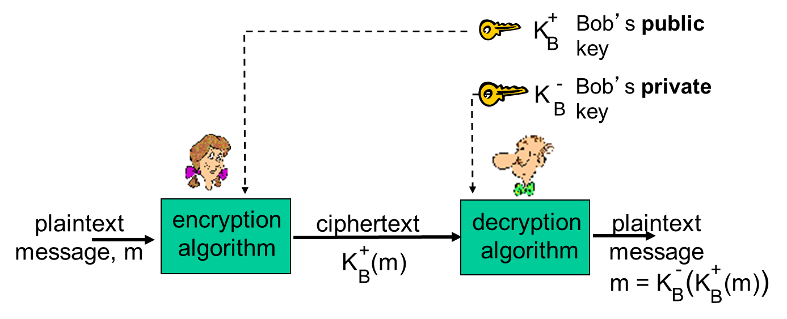
Public Key Cryptography (2 of 2)

Slide 19
Public Key Encryption Algorithms
requirements:
need
given public key
it should be impossible to compute private key
R S A: Rivest, Shamir, Adelson algorithm

Slide 20


Prerequisite: Modular Arithmetic
x mod n = remainder of x when divide by n
facts:
thus
example: x=14, n=10, d=2:

Slide 21
R S A: Getting Ready
message: just a bit pattern
bit pattern can be uniquely represented by an integer number
thus, encrypting a message is equivalent to encrypting a number
example:
m= 10010001. This message is uniquely represented by the decimal number 145.
to encrypt m, we encrypt the corresponding number, which gives a new number (the ciphertext).

Slide 22
R S A: Creating Public/Private Key Pair
choose two large prime numbers p, q. (e.g., 1024 bits each)
compute
choose e (with e<n) that has no common factors with z (e, z are “relatively prime”).
choose d such that ed−1 is exactly divisible by z. (in other words: ed mod z = 1 ).

Slide 23
R S A: Encryption, Decryption
0. given (n,e) and (n,d) as computed above
1. to encrypt message m (<n), compute
2. to decrypt received bit pattern, c, compute
magic
happens!

Slide 24
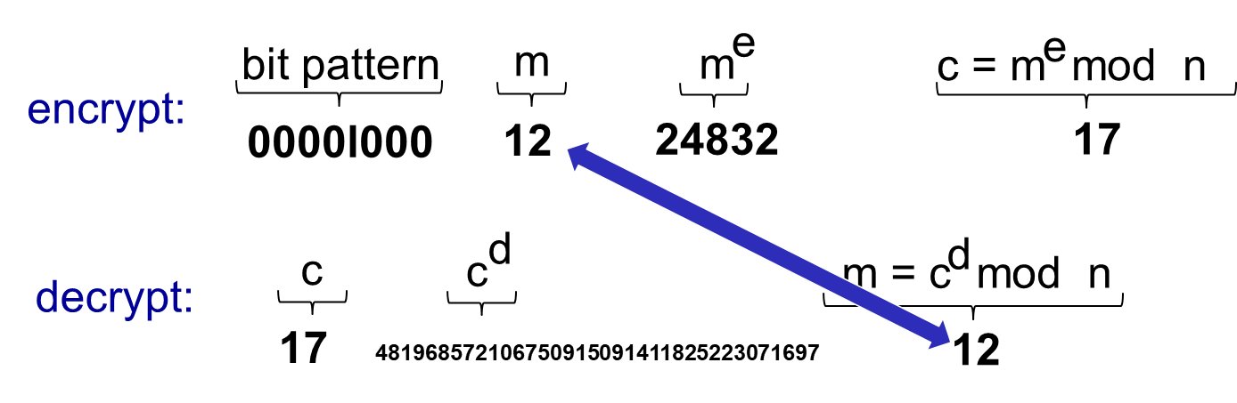
R S A Example
Bob chooses p=5, q=7. Then n=35, z=24.
e=5 (so e, z relatively prime).
d=29 (so ed-1 exactly divisible by z).
encrypting 8-bit messages.

Slide 25
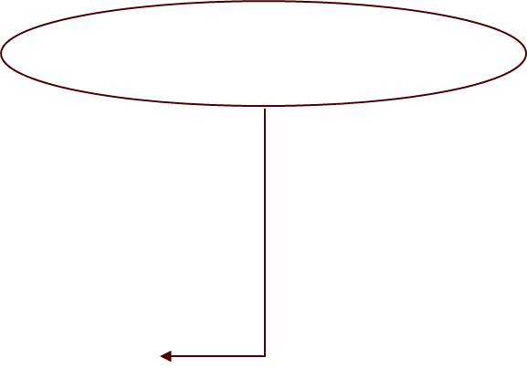
Why Does R S A Work?
must show that
fact: for any x an y:
where n= pq and
thus,

Slide 26
R S A: Another Important Property
The following property will be very useful later:
use public key first, followed by private key
use private key first, followed by public key
result is the same!

Slide 27
Why K sub B minus left parenthesis K sub B plus left parenthesis m right parenthesis right parenthesis = m = K sub B plus left parenthesis K sub B minus left parenthesis m right parenthesis right parenthesis question mark.
follows directly from modular arithmetic:

Slide 28
Why is R S A Secure?
suppose you know Bob’s public key (n,e). How hard is it to determine d?
essentially need to find factors of n without knowing the two factors p and q
fact: factoring a big number is hard

Slide 29
R S A in Practice: Session Keys
exponentiation in R S A is computationally intensive
D E S is at least 100 times faster than R S A
use public key crypto to establish secure connection, then establish second key – symmetric session key – for encrypting data
session key, K_{S}
Bob and Alice use R S A to exchange a symmetric key K_{S}
once both have K_{S}, they use symmetric key cryptography

Slide 30
Learning Objectives (3 of 9)
8.1 What is network security?
8.2 Principles of cryptography
8.3 Message integrity, authentication
8.4 Securing e-mail
8.5 Securing T C P connections: S S L
8.6 Network layer security: IPsec
8.7 Securing wireless LANs
8.8 Operational security: firewalls and I D S

Slide 31
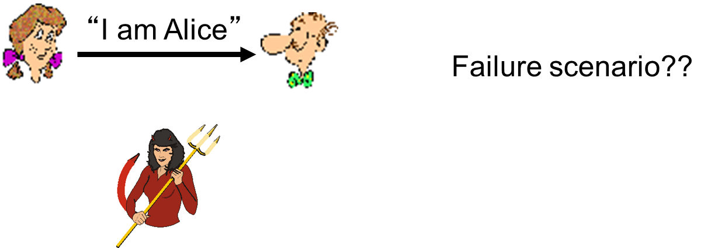
Authentication (1 of 2)
Goal: Bob wants Alice to “prove” her identity to him
Protocol ap1.0: Alice says “I am Alice”

Slide 32
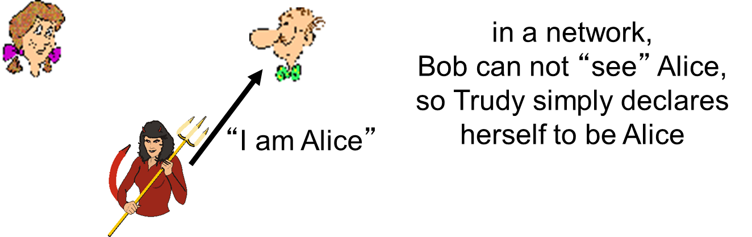
Authentication (2 of 2)
Goal: Bob wants Alice to “prove” her identity to him
Protocol ap1.0: Alice says “I am Alice”

Slide 33
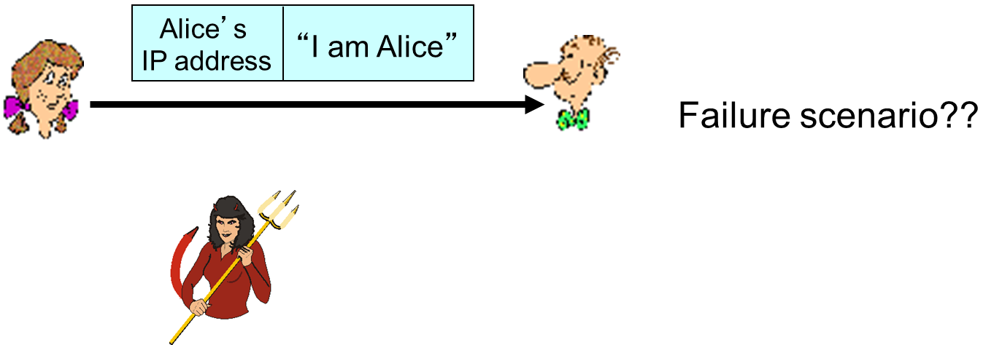
Authentication: Another Try (1 of 4)
Protocol ap2.0: Alice says “I am Alice” in an I P packet containing her source I P address

Slide 34

Authentication: Another Try (2 of 4)
Protocol ap2.0: Alice says “I am Alice” in an I P packet containing her source I P address

Slide 35
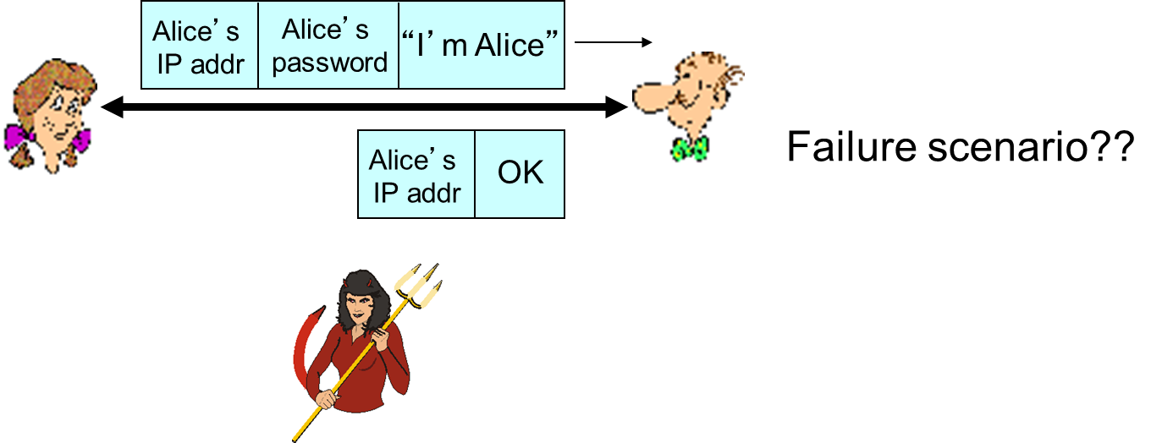
Authentication: Another Try (3 of 4)
Protocol ap3.0: Alice says “I am Alice” and sends her secret password to “prove” it.

Slide 36
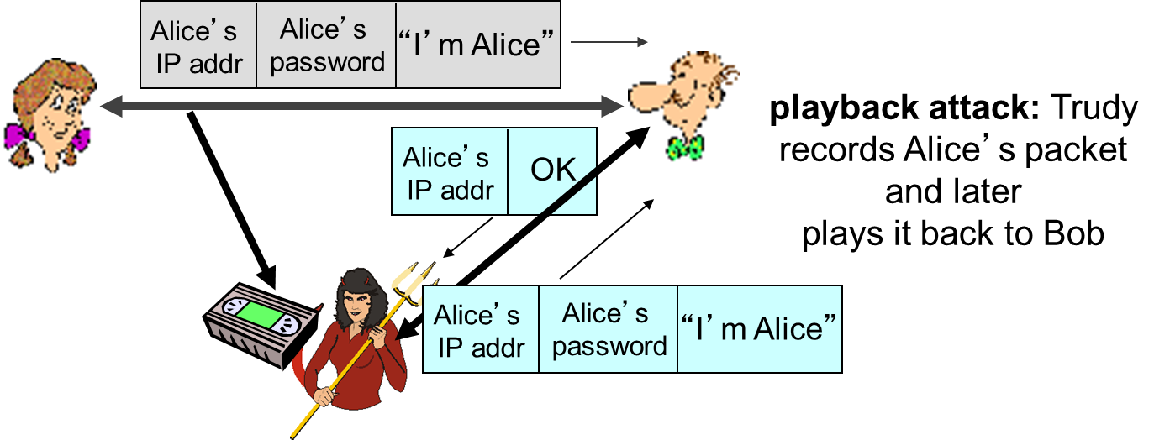
Authentication: Another Try (4 of 4)
Protocol ap3.0: Alice says “I am Alice” and sends her secret password to “prove” it.

Slide 37
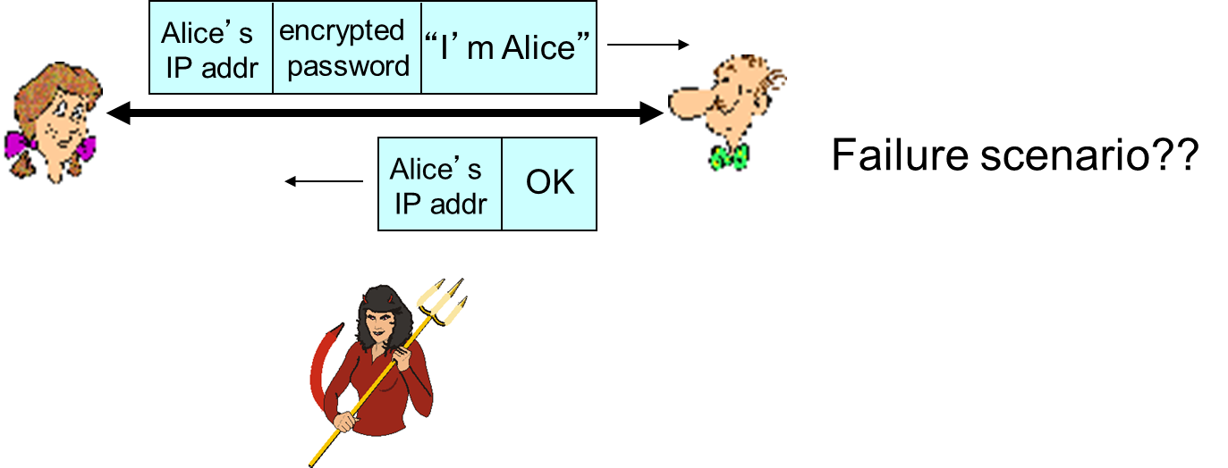
Authentication: Yet Another Try (1 of 3)
Protocol ap3.1: Alice says “I am Alice” and sends her encrypted secret password to “prove” it.

Slide 38
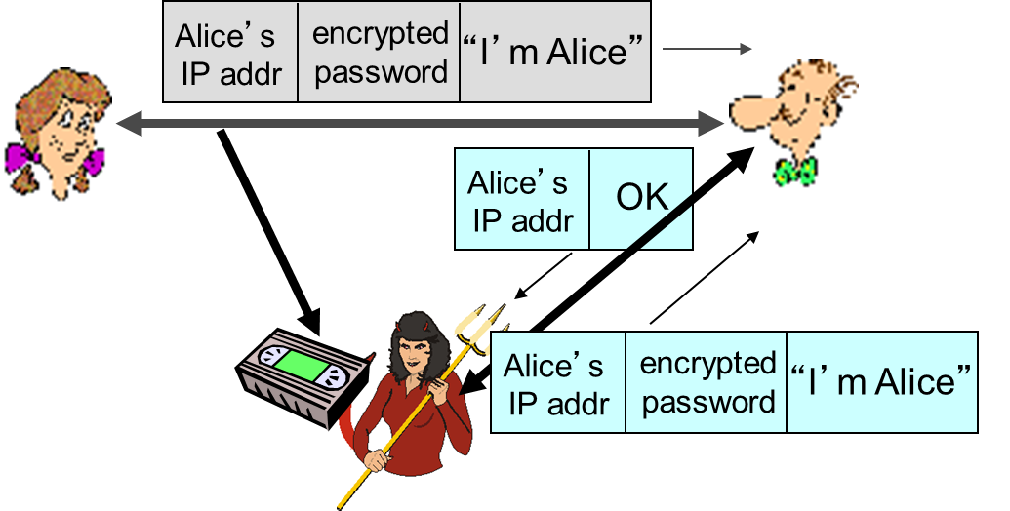
Authentication: Yet Another Try (2 of 3)
Protocol ap3.1: Alice says “I am Alice” and sends her encrypted secret password to “prove” it.
record and playback still works!

Slide 39
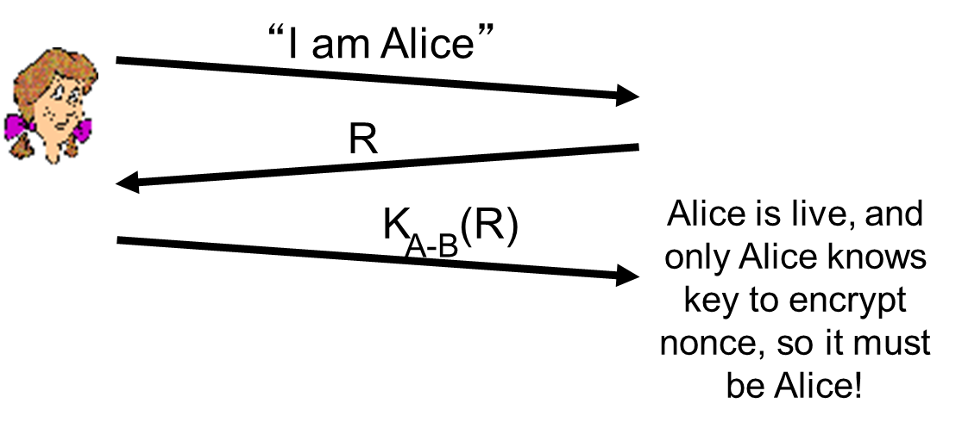
Authentication: Yet Another Try (3 of 3)
Goal: avoid playback attack
nonce: number (R) used only once-in-a-lifetime
ap4.0: to prove Alice “live”, Bob sends Alice nonce, R. Alice must return R, encrypted with shared secret key
Failures, drawbacks?

Slide 40
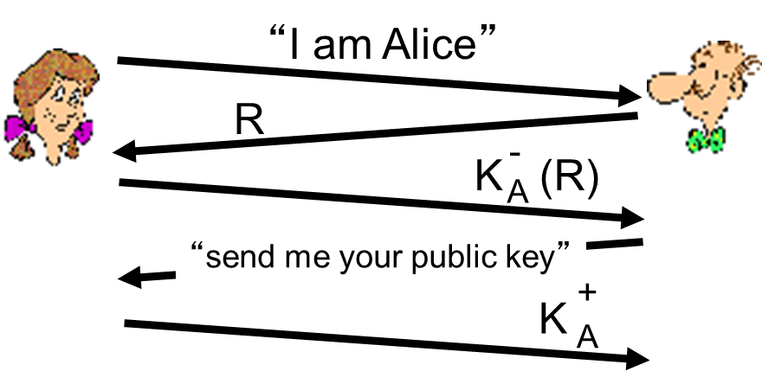
Authentication: ap5.0
ap4.0 requires shared symmetric key
can we authenticate using public key techniques?
ap5.0: use nonce, public key cryptography
Bob computes
and knows only Alice could have the private key, that encrypted R such that

Slide 41
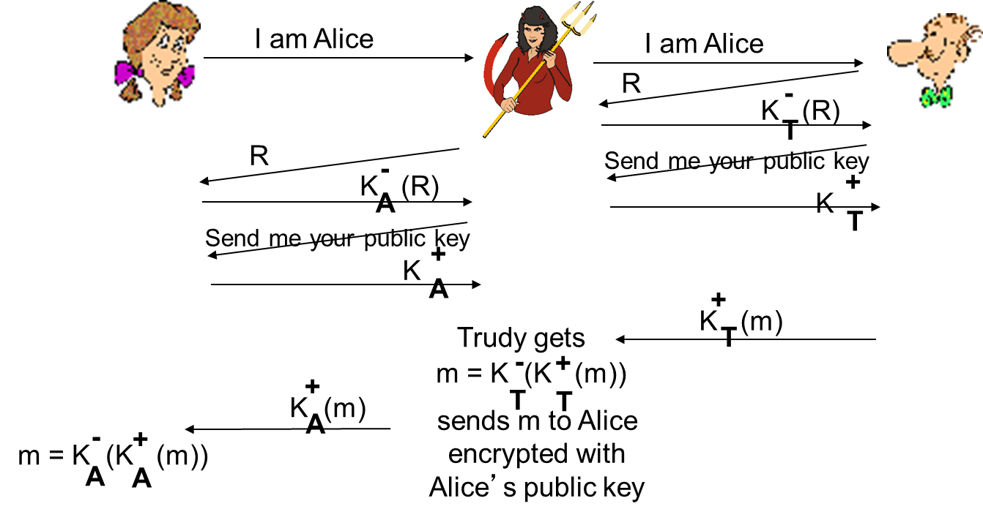
ap5.0: Security Hole (1 of 2)
man (or woman) in the middle attack: Trudy poses as Alice (to Bob) and as Bob (to Alice)

Slide 42
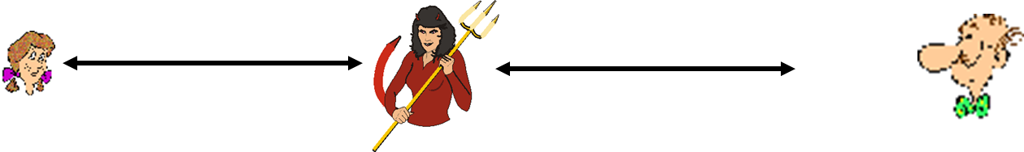
ap5.0: Security Hole (2 of 2)
man (or woman) in the middle attack: Trudy poses as Alice (to Bob) and as Bob (to Alice)
difficult to detect:
Bob receives everything that Alice sends, and vice versa. (e.g., so Bob, Alice can meet one week later and recall conversation!)
problem is that Trudy receives all messages as well!

Slide 43
Learning Objectives (4 of 9)
8.1 What is network security?
8.2 Principles of cryptography
8.3 Message integrity, authentication
8.4 Securing e-mail
8.5 Securing T C P connections: S S L
8.6 Network layer security: IPsec
8.7 Securing wireless LANs
8.8 Operational security: firewalls and I D S

Slide 44
Digital Signatures (1 of 3)
cryptographic technique analogous to hand-written signatures:
sender (Bob) digitally signs document, establishing he is document owner/creator.
verifiable, nonforgeable: recipient (Alice) can prove to someone that Bob, and no one else (including Alice), must have signed document

Slide 45
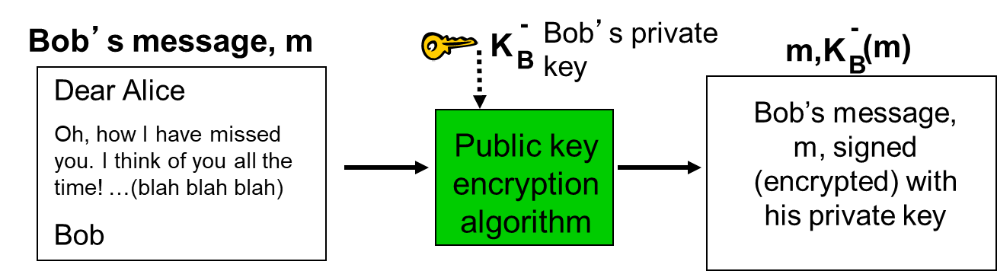
Digital Signatures (2 of 3)
simple digital signature for message m:
Bob signs m by encrypting with his private key
creating “signed” message,

Slide 46
Digital Signatures (3 of 3)
suppose Alice receives msg m, with signature:
Alice verifies m signed by Bob by applying Bob’s public key
whoever signed m must have used Bob’s private key.
If
Alice thus verifies that:
Bob signed m
no one else signed m
Bob signed m and not m’

Slide 47
Digital Signatures (4 of 4)
non-repudiation:
Alice can take m, and signature
to court and
prove that Bob signed m

Slide 48
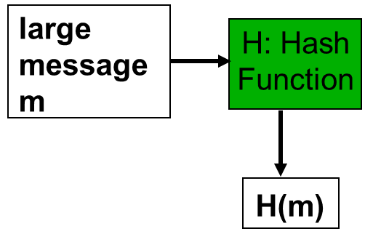
Message Digests
computationally expensive to public-key-encrypt long messages
goal: fixed-length, easy- to-compute digital “fingerprint”
apply hash function H to m, get fixed size message digest,
Hash function properties:
many-to-1
produces fixed-size msg digest (fingerprint)
given message digest x, computationally infeasible to find m such that

Slide 49
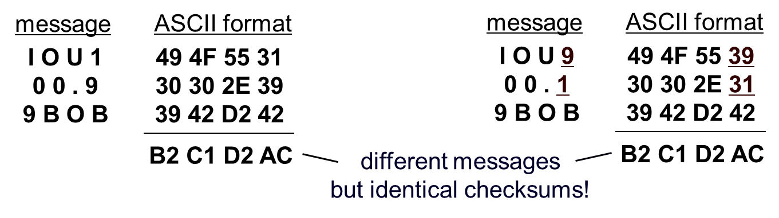
Internet Checksum: Poor Crypto Hash Function
Internet checksum has some properties of hash function:
produces fixed length digest (16-bit sum) of message is many-to-one
But given message with given hash value, it is easy to find another message with same hash value:

Slide 50
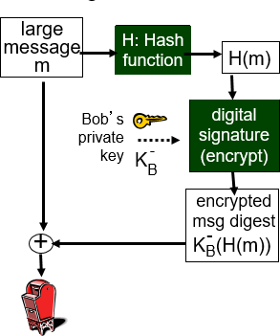
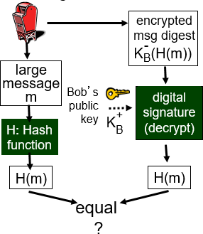
Digital Signature = Signed Message Digest
Bob sends digitally signed message:
Alice verifies signature, integrity of digitally signed message:

Slide 51
Hash Function Algorithms
MD5 hash function widely used (R F C 1321)
computes 128-bit message digest in 4-step process.
arbitrary 128-bit string x, appears difficult to construct msg m whose MD5 hash is equal to x
S H A - 1 is also used
U S standard [N I S T, F I P S P U B 180-1]
160-bit message digest

Slide 52
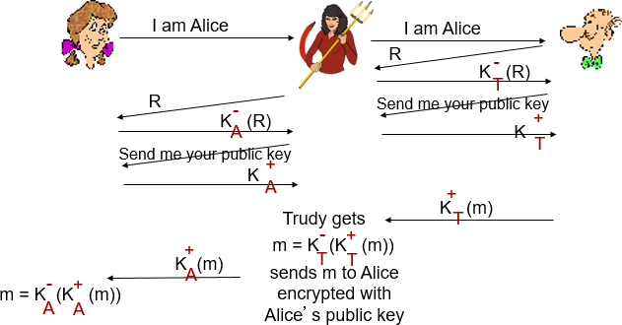
Recall: ap5.0 Security Hole
man (or woman) in the middle attack: Trudy poses as Alice (to Bob) and as Bob (to Alice)

Slide 53
Public-Key Certification
motivation: Trudy plays pizza prank on Bob
Trudy creates e-mail order: Dear Pizza Store, Please deliver to me four pepperoni pizzas. Thank you, Bob
Trudy signs order with her private key
Trudy sends order to Pizza Store
Trudy sends to Pizza Store her public key, but says it’s Bob’s public key
Pizza Store verifies signature; then delivers four pepperoni pizzas to Bob
Bob doesn’t even like pepperoni

Slide 54
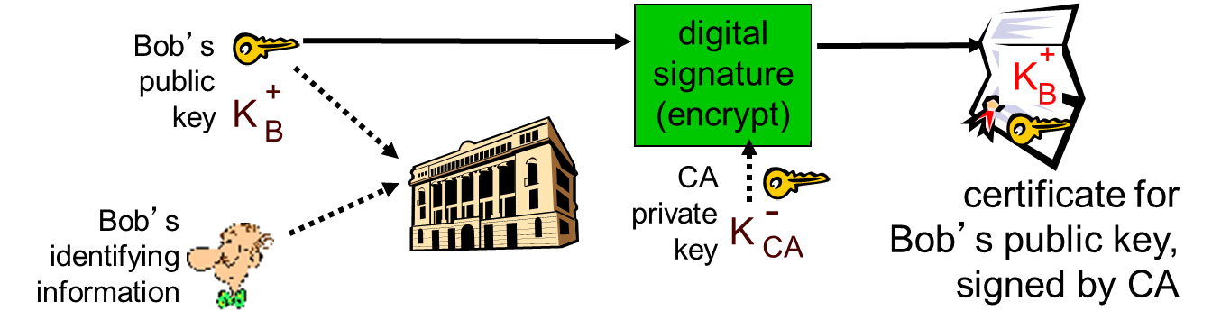
Certification Authorities (1 of 2)
certification authority (C A): binds public key to particular entity, E.
E(person, router) registers its public key with C A.
E provides “proof of identity” to C A.
C A creates certificate binding E to its public key.
certificate containing E’s public key digitally signed by C A – C A says “this is E’s public key”

Slide 55
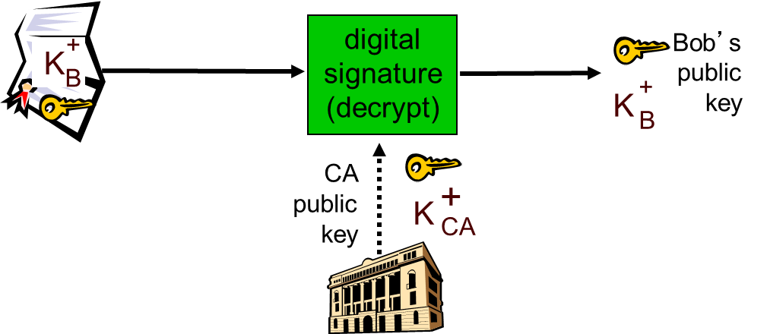
Certification Authorities (2 of 2)
when Alice wants Bob’s public key:
gets Bob’s certificate (Bob or elsewhere).
apply CA’s public key to Bob’s certificate, get Bob’s public key

Slide 56
Learning Objectives (5 of 9)
8.1 What is network security?
8.2 Principles of cryptography
8.3 Message integrity, authentication
8.4 Securing e-mail
8.5 Securing T C P connections: S S L
8.6 Network layer security: IPsec
8.7 Securing wireless LANs
8.8 Operational security: firewalls and I D S

Slide 57
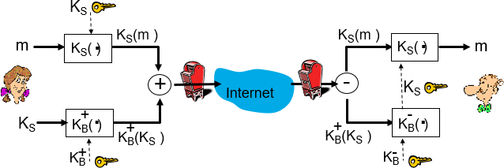
Secure E-Mail (1 of 4)
Alice wants to send confidential e-mail, m, to Bob.
Alice:
generates random symmetric private key, K_{S}
encrypts message with K_{S} (for efficiency)
also encrypts K_{S} with Bob’s public key
sends both

Slide 58
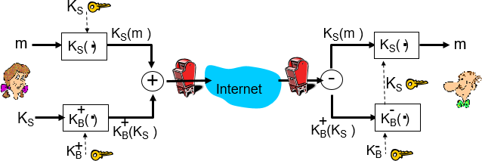
Secure E-Mail (2 of 4)
Alice wants to send confidential e-mail, m, to Bob.
Bob:
uses his private key to decrypt and recover K_{S}
uses K_{S} to decrypt

Slide 59
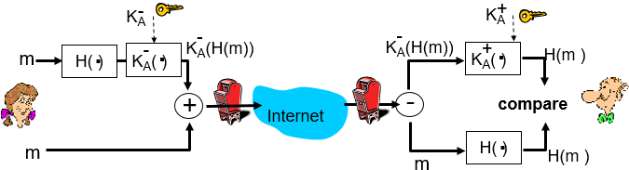
Secure E-Mail (3 of 4)
Alice wants to provide sender authentication message integrity
Alice digitally signs message
sends both message (in the clear) and digital signature

Slide 60
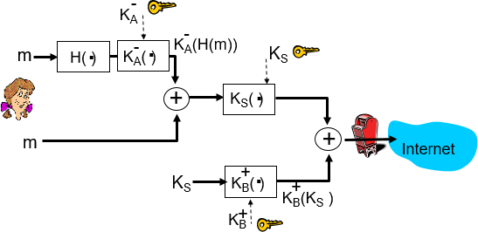
Secure E-Mail (4 of 4)
Alice wants to provide secrecy, sender authentication, message integrity.
Alice uses three keys: her private key, Bob’s public key, newly created symmetric key

Slide 61
Learning Objectives (6 of 9)
8.1 What is network security?
8.2 Principles of cryptography
8.3 Message integrity, authentication
8.4 Securing e-mail
8.5 Securing T C P connections: S S L
8.6 Network layer security: IPsec
8.7 Securing wireless LANs
8.8 Operational security: firewalls and I D S

Slide 62
S S L: Secure Sockets Layer
widely deployed security protocol
supported by almost all browsers, web servers
https
billions $/year over S S L
mechanisms: [Woo 1994], implementation: Netscape
variation -T L S: transport layer security, R F C 2246
provides
confidentiality
integrity
authentication
original goals:
Web e-commerce transactions
encryption (especially credit-card numbers)
Web-server authentication
optional client authentication
minimum hassle in doing business with new merchant
available to all T C P applications
secure socket interface

Slide 63
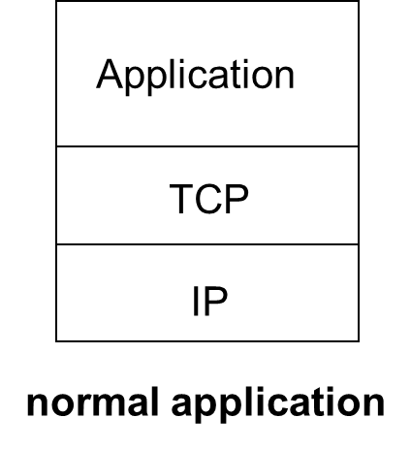
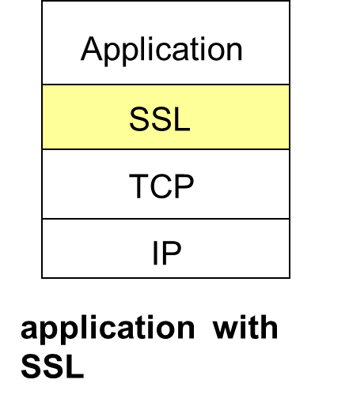
S S L and T C P / I P
S S L provides application programming interface (A P I) to applications
C and Java S S L libraries/classes readily available

Slide 64
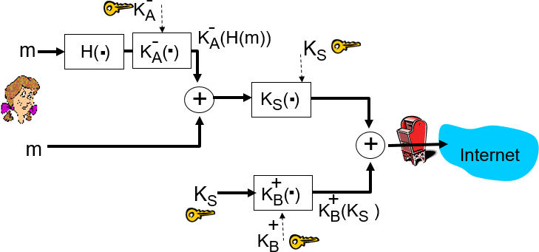
Could Do Something Like P G P:
but want to send byte streams & interactive data
want set of secret keys for entire connection
want certificate exchange as part of protocol: handshake phase

Slide 65
Toy S S L: A Simple Secure Channel
handshake: Alice and Bob use their certificates, private keys to authenticate each other and exchange shared secret
key derivation: Alice and Bob use shared secret to derive set of keys
data transfer: data to be transferred is broken up into series of records
connection closure: special messages to securely close connection

Slide 66
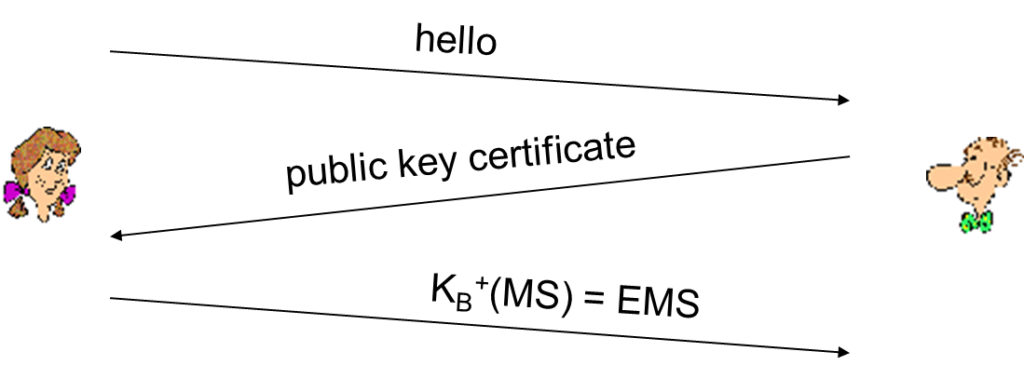
Toy: A Simple Handshake
M S: master secret
E M S: encrypted master secret

Slide 67
Toy: Key Derivation
considered bad to use same key for more than one cryptographic operation
use different keys for message authentication code (M A C) and encryption
four keys:
K_{c} = encryption key for data sent from client to server
M_{c} = M A C key for data sent from client to server
K_{s} = encryption key for data sent from server to client
M_{s} = M A C key for data sent from server to client
keys derived from key derivation function (K D F)
takes master secret and (possibly) some additional random data and creates the keys

Slide 68
Toy: Data Records
why not encrypt data in constant stream as we write it to T C P?
where would we put the M A C? If at end, no message integrity until all data processed.
e.g., with instant messaging, how can we do integrity check over all bytes sent before displaying?
instead, break stream in series of records
each record carries a M A C
receiver can act on each record as it arrives
issue: in record, receiver needs to distinguish M A C from data
want to use variable-length records

Slide 69
Toy: Sequence Numbers
problem: attacker can capture and replay record or re-order records
solution: put sequence number into M A C:
note: no sequence number field
problem: attacker could replay all records
solution: use nonce

Slide 70
Toy: Control Information
problem: truncation attack:
attacker forges T C P connection close segment
one or both sides thinks there is less data than there actually is.
solution: record types, with one type for closure
type 0 for data; type 1 for closure

Slide 71
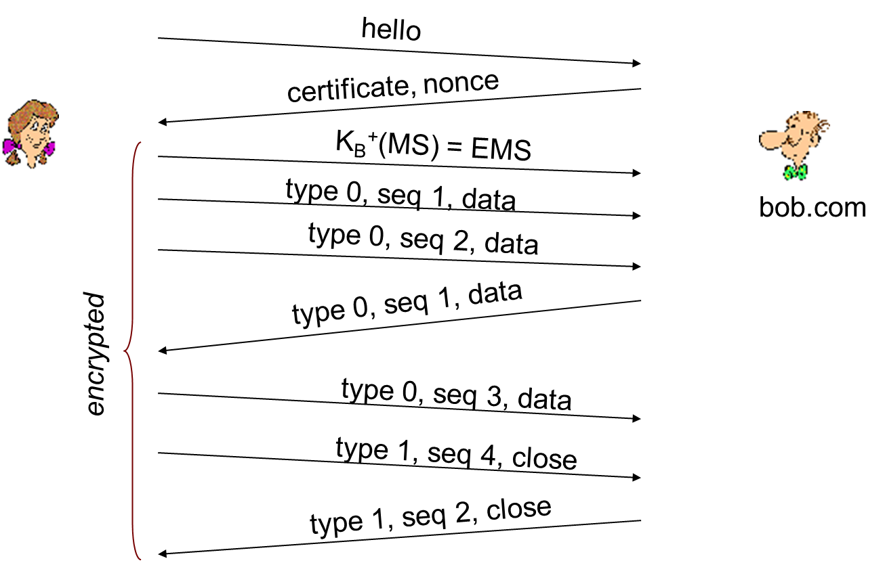
Toy S S L: Summary

Slide 72
Toy S S L Isn’T Complete
how long are fields?
which encryption protocols?
want negotiation?
allow client and server to support different encryption algorithms
allow client and server to choose together specific algorithm before data transfer

Slide 73
S S L Cipher Suite
cipher suite
public-key algorithm
symmetric encryption algorithm
M A C algorithm
S S L supports several cipher suites
negotiation: client, server agree on cipher suite
client offers choice
server picks one
common S S L symmetric ciphers
D E S – Data Encryption Standard: block
3D E S – Triple strength: block
RC2 – Rivest Cipher 2: block
RC4 – Rivest Cipher 4: stream
S S L Public key encryption
R S A

Slide 74
Real S S L: Handshake (1 of 4)
Purpose
server authentication
negotiation: agree on crypto algorithms
establish keys
client authentication (optional)

Slide 75
Real S S L: Handshake (2 of 4)
client sends list of algorithms it supports, along with client nonce
server chooses algorithms from list; sends back: choice + certificate + server nonce
client verifies certificate, extracts server’s public key, generates pre_master_secret, encrypts with server’s public key, sends to server
client and server independently compute encryption and M A C keys from pre_master_secret and nonces
client sends a M A C of all the handshake messages
server sends a M A C of all the handshake messages

Slide 76
Real S S L: Handshake (3 of 4)
last 2 steps protect handshake from tampering
client typically offers range of algorithms, some strong, some weak
man-in-the middle could delete stronger algorithms from list
last 2 steps prevent this
last two messages are encrypted

Slide 77
Real S S L: Handshake (4 of 4)
why two random nonces?
suppose Trudy sniffs all messages between Alice & Bob
next day, Trudy sets up T C P connection with Bob, sends exact same sequence of records
Bob (Amazon) thinks Alice made two separate orders for the same thing
solution: Bob sends different random nonce for each connection. This causes encryption keys to be different on the two days
Trudy’s messages will fail Bob’s integrity check

Slide 78
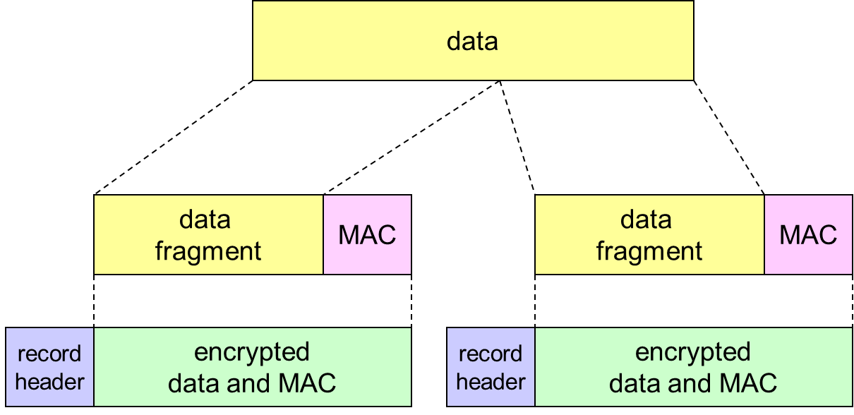
S S L Record Protocol
record header: content type; version; length
M A C: includes sequence number, M A C key M_{x}
fragment: each S S L fragment

Slide 79
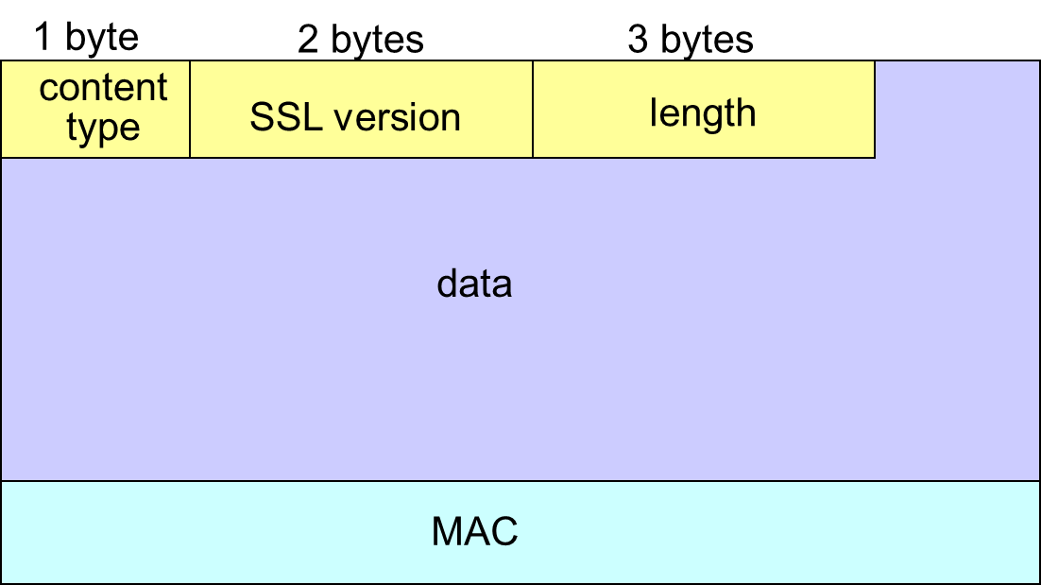
S S L Record Format
data and M A C encrypted (symmetric algorithm)

Slide 80
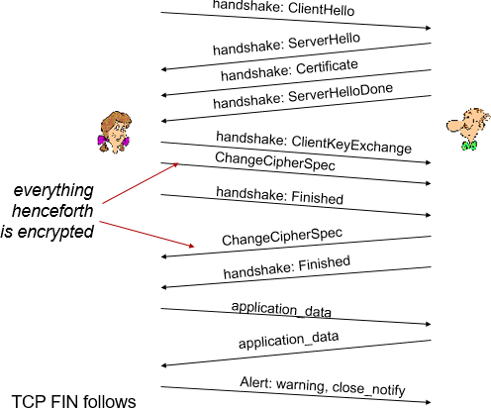
Real S S L Connection

Slide 81
Key Derivation
client nonce, server nonce, and pre-master secret input into pseudo random-number generator.
produces master secret
master secret and new nonces input into another random-number generator: “key block”
because of resumption: T B D
key block sliced and diced:
client M A C key
server M A C key
client encryption key
server encryption key
client initialization vector (I V)
server initialization vector (I V)

Slide 82
Learning Objectives (7 of 9)
8.1 What is network security?
8.2 Principles of cryptography
8.3 Message integrity, authentication
8.4 Securing e-mail
8.5 Securing T C P connections: S S L
8.6 Network layer security: IPsec
8.7 Securing wireless LANs
8.8 Operational security: firewalls and I D S

Slide 83
What is Network-Layer Confidentiality ?
between two network entities:
sending entity encrypts datagram payload, payload could be:
T C P or U D P segment, I C M P message, O S P F message ….
all data sent from one entity to other would be hidden:
web pages, e-mail, P2P file transfers, T C P S Y N packets …
“blanket coverage”

Slide 84
Virtual Private Networks (V P Ns) (1 of 2)
motivation:
institutions often want private networks for security.
costly: separate routers, links, D N S infrastructure.
V P N: institution’s inter-office traffic is sent over public Internet instead
encrypted before entering public Internet
logically separate from other traffic

Slide 85
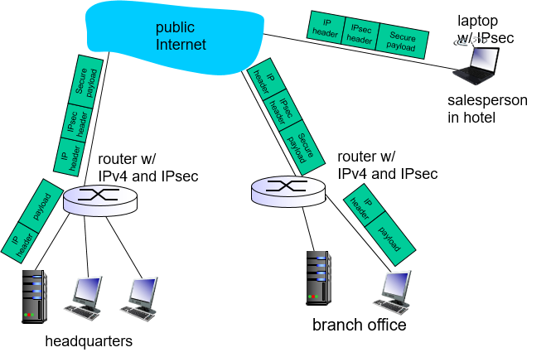
Virtual Private Networks (V P Ns) (2 of 2)

Slide 86
I Psec Services
data integrity
origin authentication
replay attack prevention
confidentiality
two protocols providing different service models:
A H
E S P

Slide 87
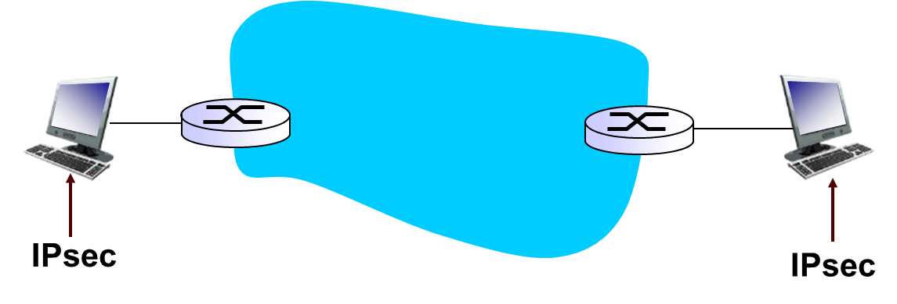
I Psec Transport Mode
I Psec datagram emitted and received by end-system
protects upper level protocols

Slide 88
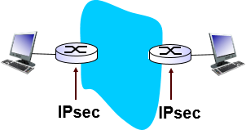
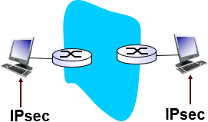
I Psec – Transport Mode
edge routers IPsec-aware
hosts IPsec-aware

Slide 89
Two I Psec Protocols
Authentication Header (A H) protocol
provides source authentication & data integrity but not confidentiality
Encapsulation Security Protocol (E S P)
provides source authentication, data integrity, and confidentiality
more widely used than A H

Slide 90
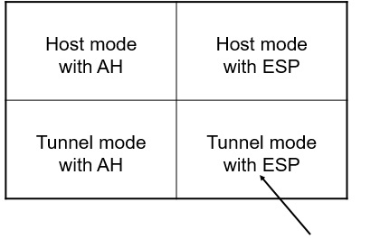
Four Combinations are Possible!
most common and most important

Slide 91
Security Associations (S As)
before sending data, “security association (S A)” established from sending to receiving entity
S As are simplex: for only one direction
ending, receiving entitles maintain state information about S A
recall: T C P endpoints also maintain state info
I P is connectionless; IPsec is connection-oriented!
how many S As in V P N w/ headquarters, branch office, and n traveling salespeople?

Slide 92
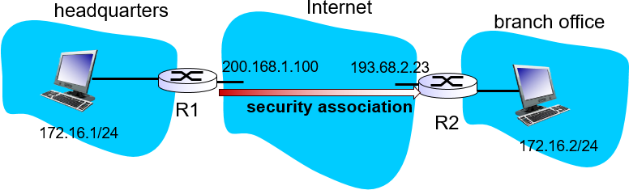
Example S A from R1 to R2 (1 of 2)
R1 stores for S A:
32-bit S A identifier: Security Parameter Index (S P I)
origin S A interface (200.168.1.100)
destination S A interface (193.68.2.23)

Slide 93
Example S A from R1 to R2 (2 of 2)
type of encryption used (e.g., 3D E S with C B C)
encryption key
type of integrity check used (e.g., H M A C with M D5)
authentication key

Slide 94
Security Association Database (S A D)
endpoint holds S A state in security association database (S A D), where it can locate them during processing.
with n salespersons, 2 + 2n S As in R1’s S A D
when sending I Psec datagram, R1 accesses S A D to determine how to process datagram.
when I Psec datagram arrives to R2, R2 examines S P I in I Psec datagram, indexes S A D with S P I, and processes datagram accordingly.

Slide 95
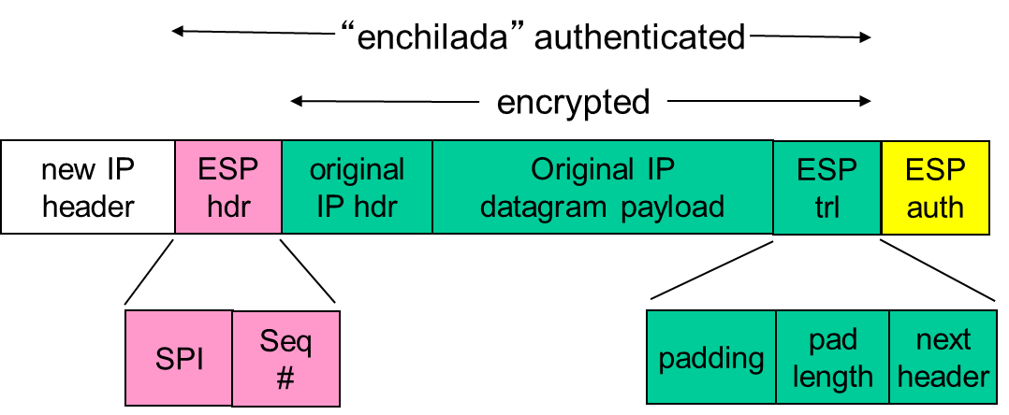
I\Psec Datagram
focus for now on tunnel mode with E S P

Slide 96
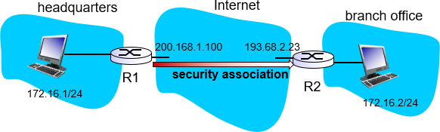
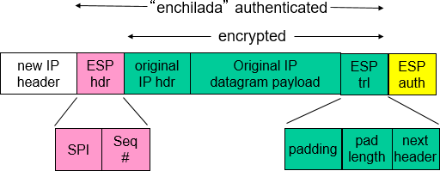
What Happens?

Slide 97
R1: Convert Original Datagram to I Psec Datagram
appends to back of original datagram (which includes original header fields!) an “E S P trailer” field.
encrypts result using algorithm & key specified by S A.
appends to front of this encrypted quantity the “E S P header”, creating “enchilada”.
creates authentication M A C over the whole enchilada, using algorithm and key specified in S A;
appends M A C to back of enchilada, forming payload;
creates brand new I P header, with all the classic I Pv4 header fields, which it appends before payload

Slide 98
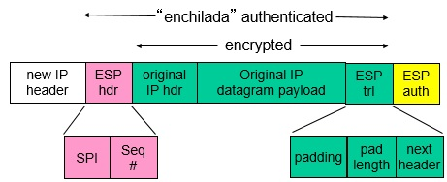
Inside the Enchilada:
E S P trailer: Padding for block ciphers
E S P header:
S P I, so receiving entity knows what to do
Sequence number, to thwart replay attacks
M A C in E S P auth field is created with shared secret key

Slide 99
I Psec Sequence Numbers
for new S A, sender initializes seq. # to 0
each time datagram is sent on S A:
sender increments seq # counter
places value in seq # field
goal:
prevent attacker from sniffing and replaying a packet
receipt of duplicate, authenticated I P packets may disrupt service
method:
destination checks for duplicates
doesn’t keep track of all received packets; instead uses a window

Slide 100
Security Policy Database (S P D)
policy: For a given datagram, sending entity needs to know if it should use I Psec
needs also to know which S A to use
may use: source and destination I P address; protocol number
info in S P D indicates “what” to do with arriving datagram
info in S A D indicates “how” to do it

Slide 101

Summary: I Psec Services
suppose Trudy sits somewhere between R1 and R2. she doesn’t know the keys.
will Trudy be able to see original contents of datagram? How about source, dest I P address, transport protocol, application port?
flip bits without detection?
masquerade as R1 using R1’s I P address?
replay a datagram?

Slide 102
I K E: Internet Key Exchange
previous examples: manual establishment of I Psec SAs in I Psec endpoints:
Example S A
S P I: 12345
Source I P: 200.168.1.100
Dest I P: 193.68.2.23
Protocol: E S P
Encryption algorithm: 3D E S-cbc
H M A C algorithm: M D5
Encryption key: 0x7aeaca…
H M A C key:0xc0291f…
manual keying is impractical for V P N with 100s of endpoints
instead use I Psec I K E (Internet Key Exchange)

Slide 103
I K E: P S K and P K I
authentication (prove who you are) with either
pre-shared secret (P S K) or
with P K I (pubic/private keys and certificates).
P S K: both sides start with secret
run I K E to authenticate each other and to generate IPsec SAs (one in each direction), including encryption, authentication keys
P K I: both sides start with public/private key pair, certificate
run I K E to authenticate each other, obtain I Psec S As (one in each direction).
similar with handshake in S S L.

Slide 104
I K E Phases
I K E has two phases
phase 1: establish bi-directional I K E S A
note: I K E S A different from I Psec S A
aka I S A K M P security association
phase 2: I S A K M P is used to securely negotiate I Psec pair of S As
phase 1 has two modes: aggressive mode and main mode
aggressive mode uses fewer messages
main mode provides identity protection and is more flexible

Slide 105
I Psec Summary
I K E message exchange for algorithms, secret keys, S P I numbers
either A H or E S P protocol (or both)
A H provides integrity, source authentication
E S P protocol (with A H) additionally provides encryption
IPsec peers can be two end systems, two routers/firewalls, or a router/firewall and an end system

Slide 106
Learning Objectives (8 of 9)
8.1 What is network security?
8.2 Principles of cryptography
8.3 Message integrity, authentication
8.4 Securing e-mail
8.5 Securing T C P connections: S S L
8.6 Network layer security: IPsec
8.7 Securing wireless LANs
8.8 Operational security: firewalls and I D S

Slide 107

W E P Design Goals
symmetric key crypto
confidentiality
end host authorization
data integrity
self-synchronizing: each packet separately encrypted
given encrypted packet and key, can decrypt; can continue to decrypt packets when preceding packet was lost (unlike Cipher Block Chaining (C B C) in block ciphers)
Efficient
implementable in hardware or software

Slide 108

Review: Symmetric Stream Ciphers
combine each byte of keystream with byte of plaintext to get ciphertext:
W E P uses R C4

Slide 109

Stream Cipher and Packet Independence
recall design goal: each packet separately encrypted
if for frame n+1, use keystream from where we left off for frame n, then each frame is not separately encrypted
need to know where we left off for packet n
W E P approach: initialize keystream with key + new I V for each packet:

Slide 110
W E P Encryption (1 of 2)
sender calculates Integrity Check Value (I C V, four-byte hash/C R C over data
each side has 104-bit shared key
sender creates 24-bit initialization vector (I V), appends to key: gives 128-bit key
sender also appends keyI D (in 8-bit field)
128-bit key inputted into pseudo random number generator to get keystream

Slide 111

W E P Encryption (2 of 2)
data in frame + I C V is encrypted with R C4:
bytes of keystream are X O Red with bytes of data & I C V
I V & keyI D are appended to encrypted data to create payload
payload inserted into 802.11 frame

Slide 112

W E P Encryption 2
new I V for each frame

Slide 113

W E P Decryption Overview
receiver extracts I V
inputs I V, shared secret key into pseudo random generator, gets keystream
X O Rs keystream with encrypted data to decrypt data + I C V
verifies integrity of data with I C V
note: message integrity approach used here is different from M A C (message authentication code) and signatures (using P K I).

Slide 114

End-Point Authentication W/ Nonce
Nonce: number (R) used only once –in-a-lifetime
How to prove Alice “live”: Bob sends Alice nonce, R. Alice must return R, encrypted with shared secret key

Slide 115

W E P Authentication
Notes:
not all A Ps do it, even if W E P is being used
A P indicates if authentication is necessary in beacon frame
done before association

Slide 116

Breaking 802.11 W E P Encryption
security hole:
24-bit I V, one I V per frame,
I V’s eventually reused
I V transmitted in plaintext
I V reuse detected
attack:
Trudy causes Alice to encrypt known plaintext d₁ d₂ d₃ d₄ …
Trudy sees: c_{i} = d_{i} XOR
Trudy knows c_{i} d_{i}, so can compute
Trudy knows encrypting key sequence
Next time I V is used, Trudy can decrypt!

Slide 117
802.11i: Improved Security
numerous (stronger) forms of encryption possible
provides key distribution
uses authentication server separate from access point

Slide 118

802.11i: Four Phases of Operation

Slide 119

E A P: Extensible Authentication Protocol
E A P: end-end client (mobile) to authentication server protocol
E A P sent over separate “links”
mobile-to-A P (E A P over L A N)
A P to authentication server (RADIUS over U D P)

Slide 120
Learning Objectives (9 of 9)
8.1 What is network security?
8.2 Principles of cryptography
8.3 Message integrity, authentication
8.4 Securing e-mail
8.5 Securing T C P connections: S S L
8.6 Network layer security: IPsec
8.7 Securing wireless LANs
8.8 Operational security: firewalls and I D S

Slide 121

Firewalls
Firewalls
isolates organization’s internal net from larger Internet, allowing some packets to pass, blocking others

Slide 122
Firewalls: Why
prevent denial of service attacks:
S Y N flooding: attacker establishes many bogus T C P connections, no resources left for “real” connections
prevent illegal modification/access of internal data
e.g., attacker replaces C I A’ s homepage with something else
allow only authorized access to inside network
set of authenticated users/hosts
three types of firewalls:
stateless packet filters
stateful packet filters
application gateways

Slide 123

Stateless Packet Filtering
internal network connected to Internet via router firewall
router filters packet-by-packet, decision to forward/drop packet based on:
source I P address, destination I P address
T C P/U D P source and destination port numbers
I C M P message type
T C P S Y N and A C K bits

Slide 124
Stateless Packet Filtering: Example
example 1: block incoming and outgoing datagrams with I P protocol field = 17 and with either source or dest port = 23
result: all incoming, outgoing U D P flows and telnet connections are blocked
example 2: block inbound T C P segments with A C K = 0.
result: prevents external clients from making T C P connections with internal clients, but allows internal clients to connect to outside.

Slide 125
Stateless Packet Filtering: More Examples
Policy | Firewall Setting
No outside Web access. | Drop all outgoing packets to any I P address, port 80
No incoming T C P connections, except those for institution’s public Web server only. | Drop all incoming T C P S Y N packets to any IP except 130.207.244.203, port 80
Prevent Web-radios from eating up the available bandwidth. | Drop all incoming U D P packets - except D N S and router broadcasts.
Prevent your network from being used for a smurf DoS attack. | Drop all I C M P packets going to a “broadcast” address (e.g. 130.207.255.255).
Prevent your network from being tracerouted | Drop all outgoing I C M P T T L expired traffic

Slide 126
Access Control Lists
A C L: table of rules, applied top to bottom to incoming packets: (action, condition) pairs: looks like OpenFlow forwarding (Ch. 4)!
action | source address | dest address | protocol | source port | dest port | flag bit
allow | 222.22/16 | outside of 222.22/16 | T C P | > 1023 | 80 | any
allow | outside of 222.22/16 | 222.22/16 | T C P | 80 | > 1023 | A C K
allow | 222.22/16 | outside of 222.22/16 | U D P | > 1023 | 53 | ---
allow | outside of 222.22/16 | 222.22/16 | U D P | 53 | > 1023 | ----
deny | all | all | all | all | all | all

Slide 127
Stateful Packet Filtering (1 of 2)
stateless packet filter: heavy handed tool
admits packets that “make no sense,” e.g., dest port = 80, A C K bit set, even though no T C P connection established:
action | source address | dest address | protocol | source port | dest port | flag bit
allow | outside of 222.22/16 | 222.22/16 | T C P | 80 | > 1023 | A C K
stateful packet filter: track status of every T C P connection
track connection setup (S Y N), teardown (F I N): determine whether incoming, outgoing packets “makes sense”
timeout inactive connections at firewall: no longer admit packets

Slide 128
Stateful Packet Filtering (2 of 2)
A C L augmented to indicate need to check connection state table before admitting packet
action | source address | dest address | proto | source port | dest port | flag bit | check conxion
allow | 222.22/16 | outside of 222.22/16 | T C P | > 1023 | 80 | any | Blank
allow | outside of 222.22/16 | 222.22/16 | T C P | 80 | > 1023 | A C K | X
allow | 222.22/16 | outside of 222.22/16 | U D P | > 1023 | 53 | --- | Blank
allow | outside of 222.22/16 | 222.22/16 | U D P | 53 | > 1023 | ---- | X
deny | all | all | all | all | all | all | Blank

Slide 129

Application Gateways
filter packets on application data as well as on I P / T C P / U D P fields.
example: allow select internal users to telnet outside
require all telnet users to telnet through gateway.
for authorized users, gateway sets up telnet connection to dest host. Gateway relays data between 2 connections
router filter blocks all telnet connections not originating from gateway.

Slide 130
Limitations of Firewalls, Gateways
I P spoofing: router can’t know if data “really” comes from claimed source
if multiple app’s. need special treatment, each has own app. gateway
client software must know how to contact gateway.
e.g., must set I P address of proxy in Web browser
filters often use all or nothing policy for U D P
tradeoff: degree of communication with outside world, level of security
many highly protected sites still suffer from attacks

Slide 131
Intrusion Detection Systems (1 of 2)
packet filtering:
operates on T C P / I P headers only
no correlation check among sessions
I D S: intrusion detection system
deep packet inspection: look at packet contents (e.g., check character strings in packet against database of known virus, attack strings)
examine correlation among multiple packets
port scanning
network mapping
DoS attack

Slide 132

Intrusion Detection Systems (2 of 2)
multiple I D Ss: different types of checking at different locations

Slide 133
Network Security (Summary)
basic techniques…...
cryptography (symmetric and public)
message integrity
end-point authentication
…. used in many different security scenarios
secure email
secure transport (S S L)
I P sec
802.11
operational security: firewalls and I D S

Slide 134

Copyright

